Slide 1
Solve Theme Problems with the “Enhanced Theme Provider” control
Fabio Franzini – CEO Apvee Solutions – Microsoft MVP

Slide 2
Agenda
Problems to solve
Usage scenarios
Introduction to the “Enhanced Theme Provider” control, how it was implemented and how to use it in SPFx
Demo
References

Slide 3
Problems to solve
The reasons behind this control are relate to solving basic style problems using the Fluent UI controls currently officially supported by SPFx, namely:
Problems with Teams theme support, when hosting a Web Part like Tab or Personal App and specifically the lack of support by the version of Fluent UI React supported by SPFx of Teams theme (most problems with “high contrast theme”).
Lack of basic style, such as fonts, for basic HTML elements when
Creating Web Parts hosted in Teams as Tabs or Personal App.
Creating Web Parts in isolated mode aka the “Isolated Web Parts”

Slide 4
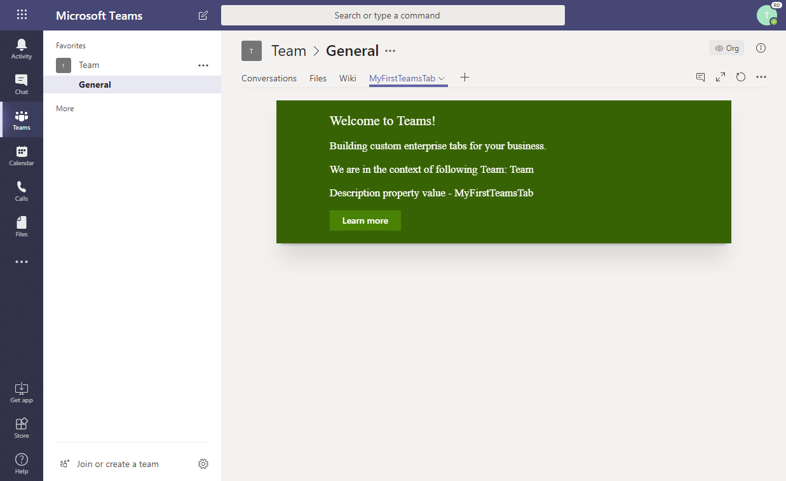
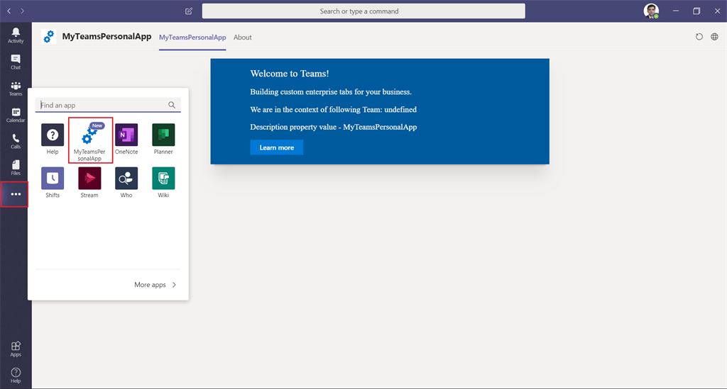
Usage scenarios - Teams
Team Tab
Personal App

Slide 5
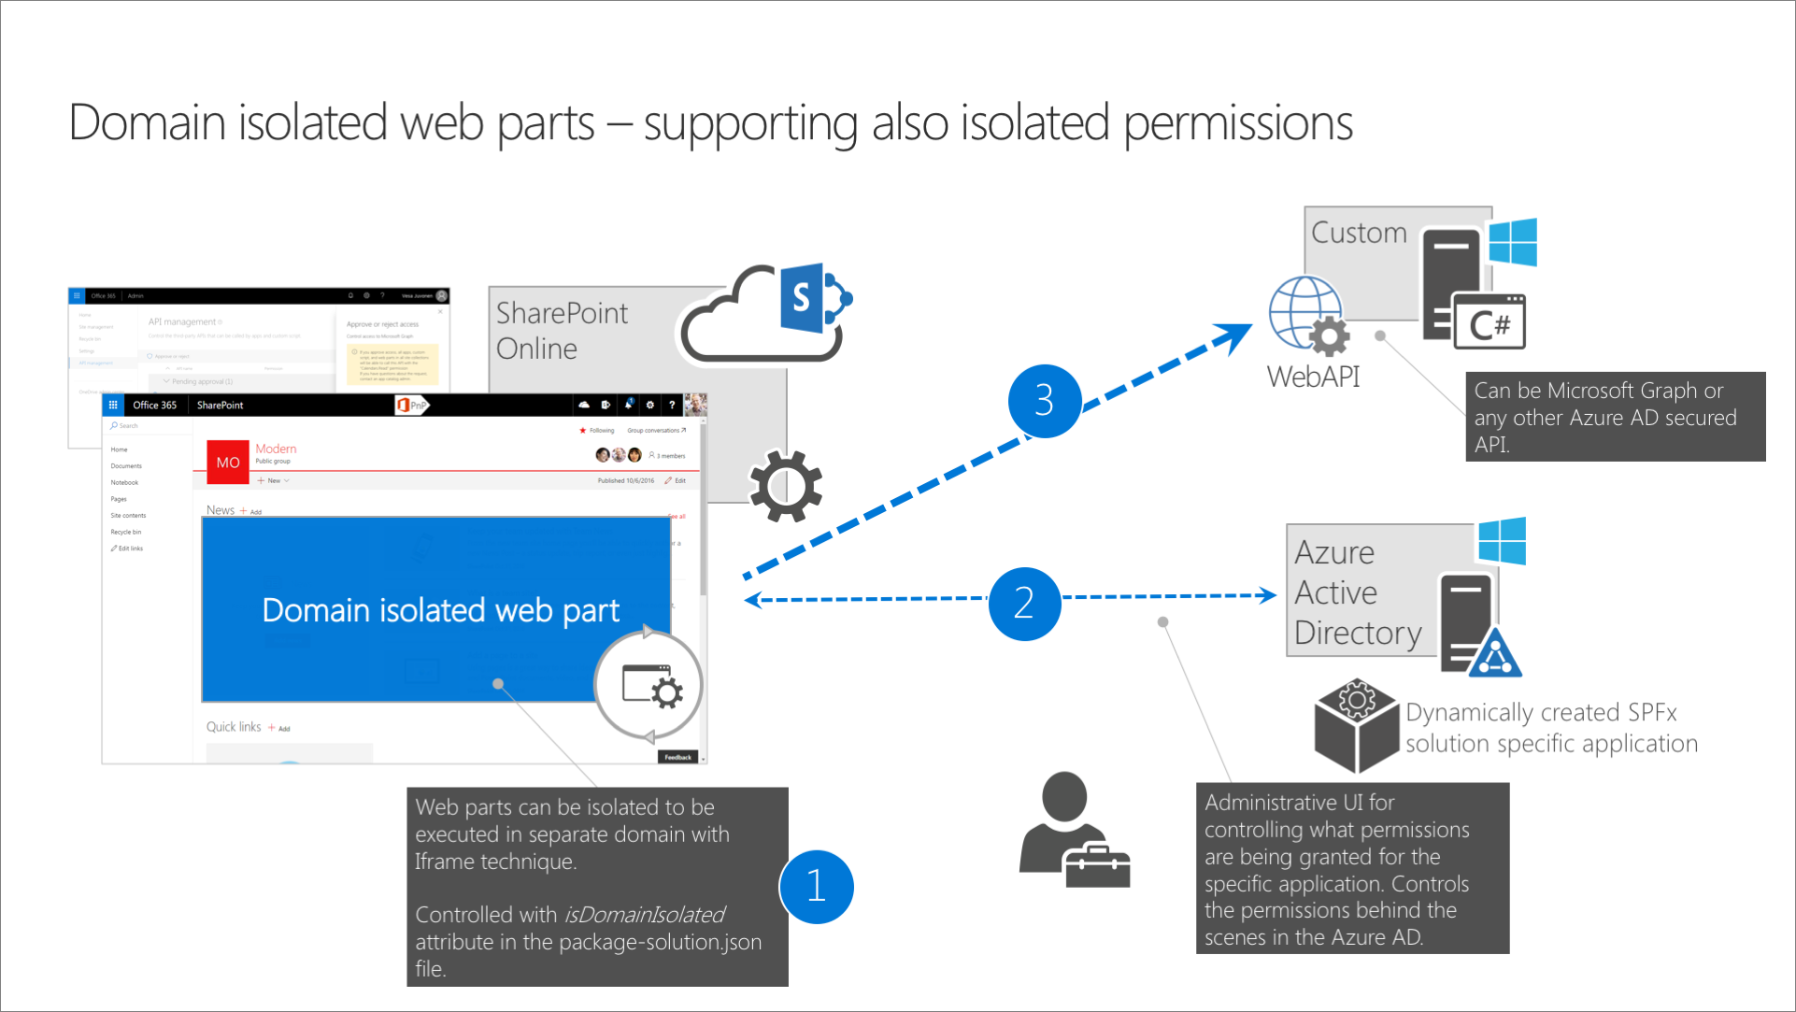
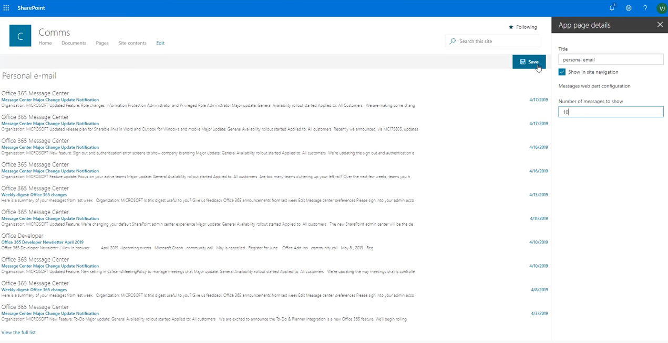
Usage scenarios - Isolated Web Parts
Isolated Web Parts
Usage “Isolated Web Part” as “Single Part App Page”

Slide 6
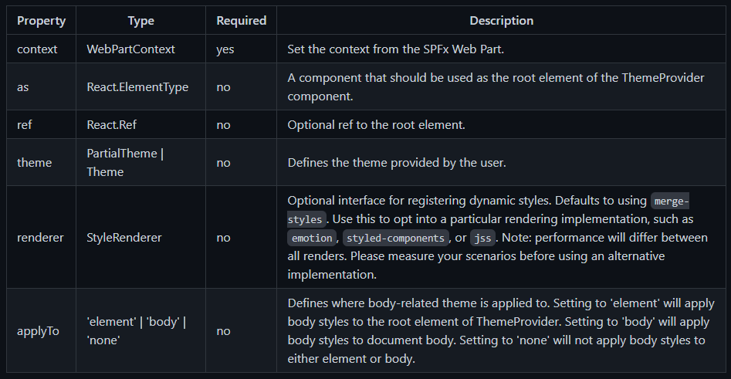
“Enhanced Theme Provider” control
Considered as a sort of wrapper for all react and non-react controls that you want to add to the WebPart.
Extends the functionality of the Fluent UI ThemeProvider control (currently in version 7) by adding some logic thanks to the information contained in the 'context' property:
If the Web Part is hosted in SharePoint, the theme passed through the 'Theme' property will be used or the default one of the current site will be taken
If the Web Part is hosted in Teams, the "Theme" property will be ignored, using the "Context" property checks which theme is currently applied and will use the custom themes to mimic the Teams Themes.

Slide 7
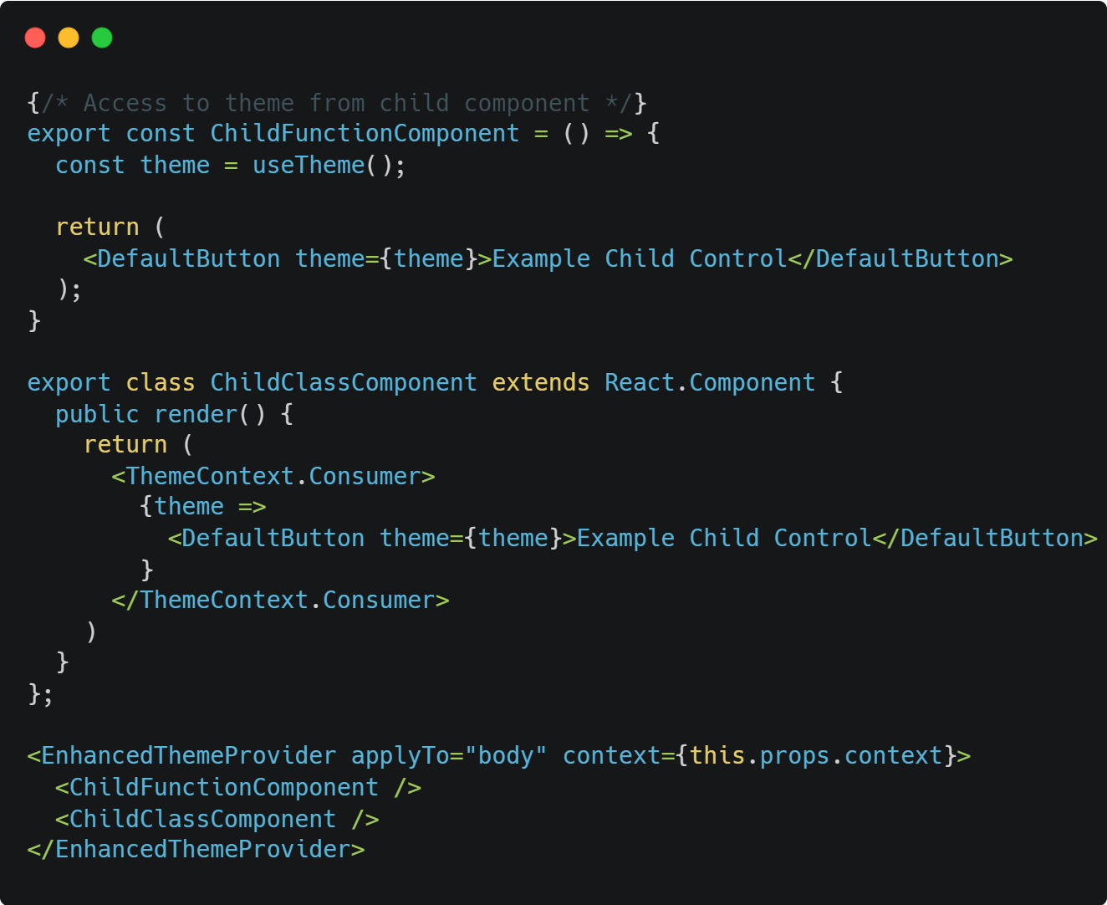
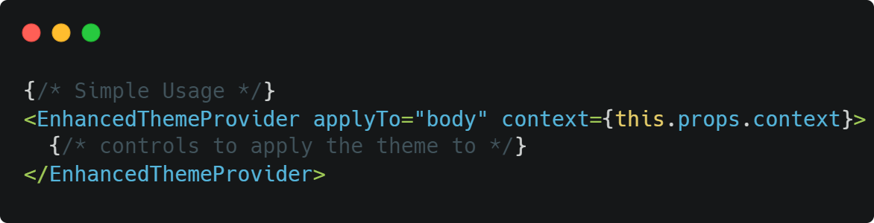
“Enhanced Theme Provider” control
Simple Usage
Access theme from child component

Slide 8
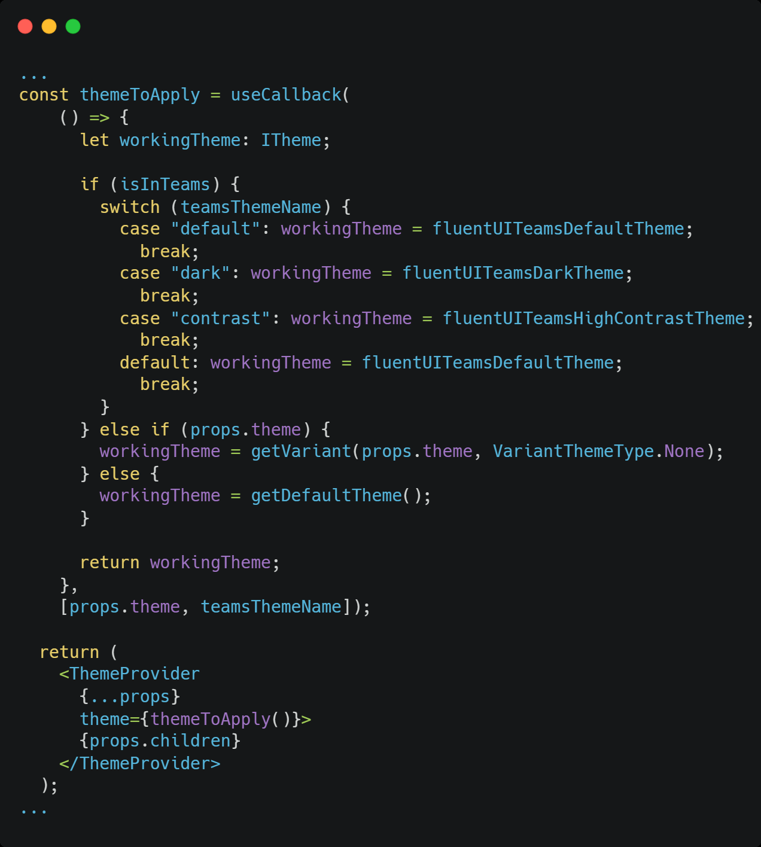
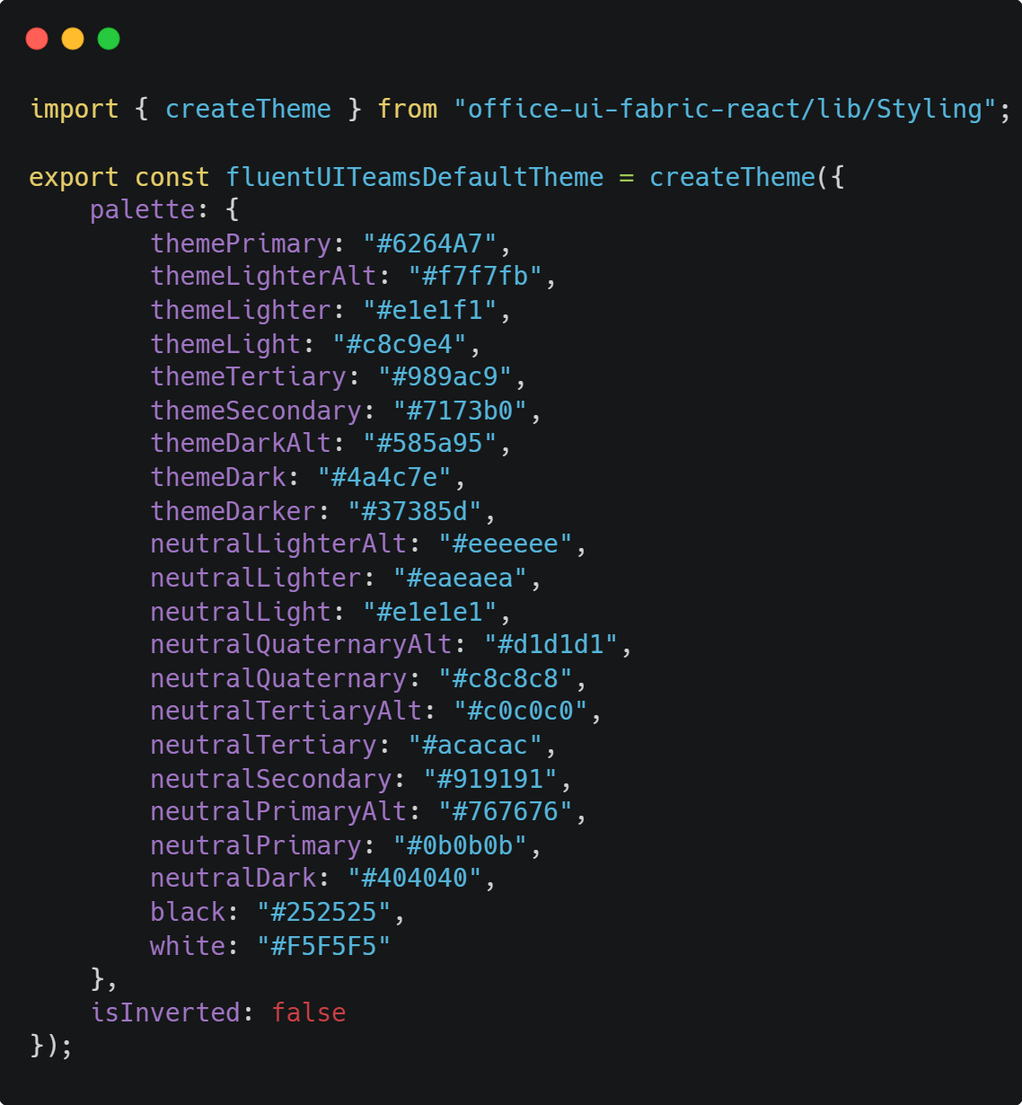
“Enhanced Theme Provider” control
Portion of the source code
Source code of “Default Teams Theme”

Slide 9
DEMO
Microsoft Teams
&
SharePoint Isolated Single Part App Page

Slide 10

About Me
I’m CEO at Apvee Solutions, startup focused on building solutions on top of Microsoft 365 ecosystem.
I'm a Microsoft MVP in Office Development and Business Applications categories.
Mail: fabio@apvee.com
Twitter: @franzinifabio
LinkedIn: www.linkedin.com/in/fabiofranzini
GitHub: https://github.com/fabiofranzini

Slide 11
References
https://docs.microsoft.com/en-us/sharepoint/dev/spfx/web-parts/get-started/using-web-part-as-ms-teams-tab
https://docs.microsoft.com/en-us/sharepoint/dev/spfx/web-parts/isolated-web-parts
https://www.npmjs.com/package/@fluentui/react-theme-provider

Slide 12
Thank you!
Fabio Franzini – CEO Apvee Solutions – Microsoft MVP

